Slide 1
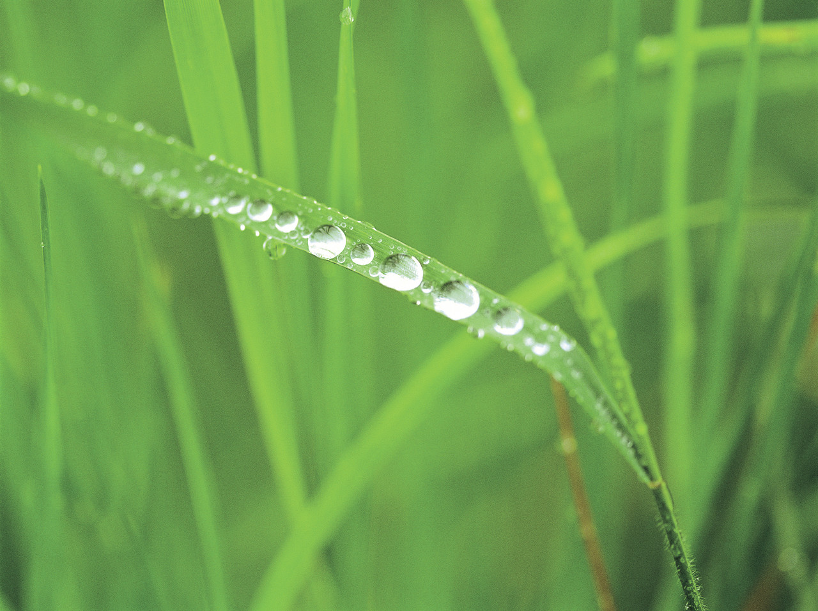
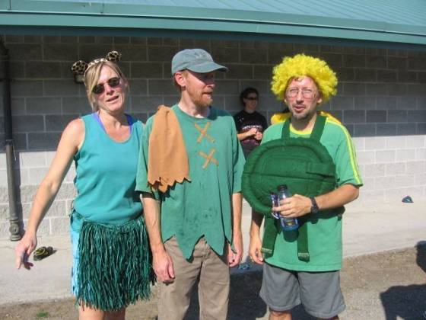


4th Annual
Salmon River Trail Race
Friday, October 3
at 3:00 pm
4-person relay race
6.6 km relay course
Begins at the soccer/rugby field next to the cell phone tower
The Lean Green Running Machine
Prizes are offered for
fastest team (male, female, mixed)
fastest individual (male, female)
best-dressed team
best named team
Contact: Prof. Karen Steensma
steensma@twu.ca for more details
The race will be held rain or shine.

